Slide 1

Employment Data: Classification and Prediction
DDS Case Study 2
Sean McWhirter

Slide 2


Agenda
Review the tasks
Overview of the dataset
Exploratory Data Analysis (EDA)
Attrition Classification
Monthly Income Prediction
Conclusion

Slide 3
The Tasks
Classification
Use the data provided to determine which three variables are the best predictor for employee attrition
Prediction
Use linear regression to develop a model to predict salary

Slide 4
The Data
36 Different Variables
870 Individual Observations
9 Factor / 27 Numerical
Missing Values: 0

Slide 5
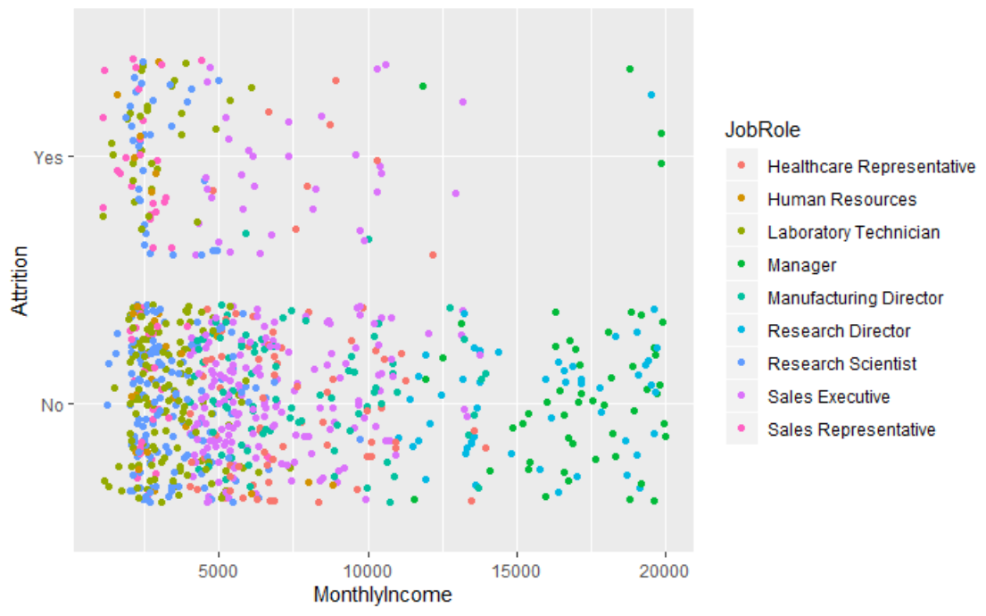
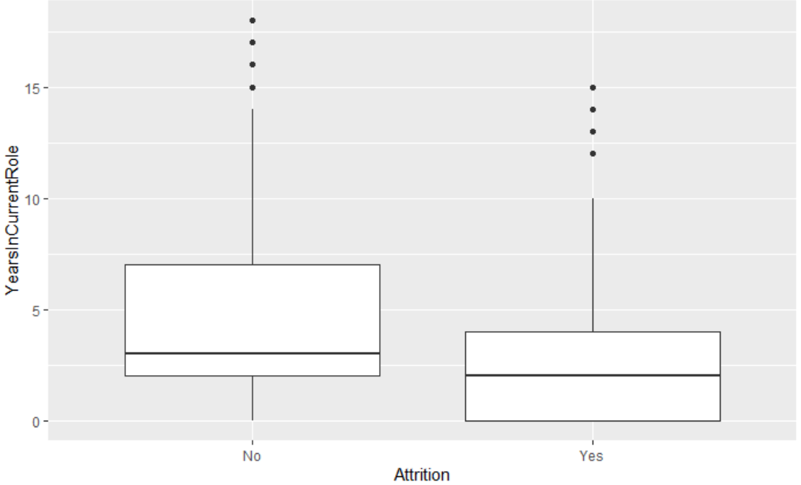
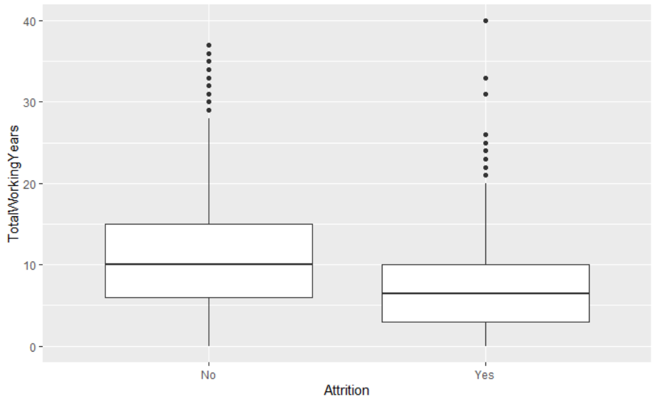
Exploratory Data Analysis (EDA)
Attrition
Yes: 140 (16.1%)
No: 730

Slide 6
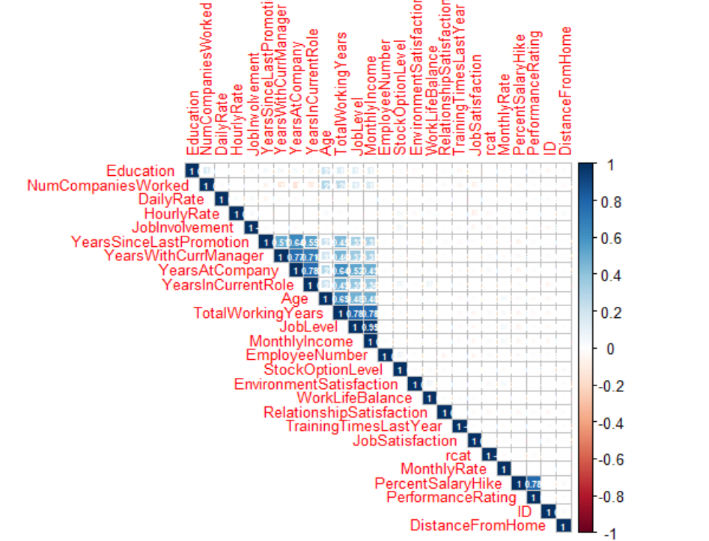
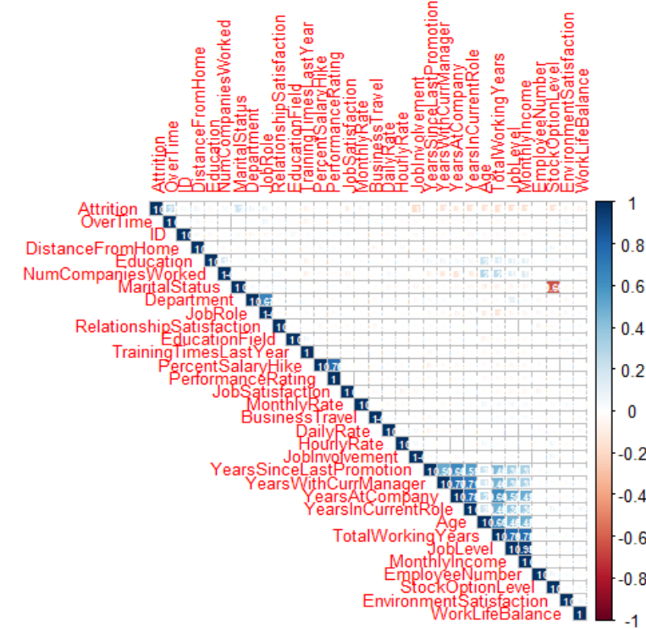
Exploratory Data Analysis (EDA)
Correlation Plot of Numeric Variables
Correlation Plot of Numeric Variables with Attrition

Slide 7
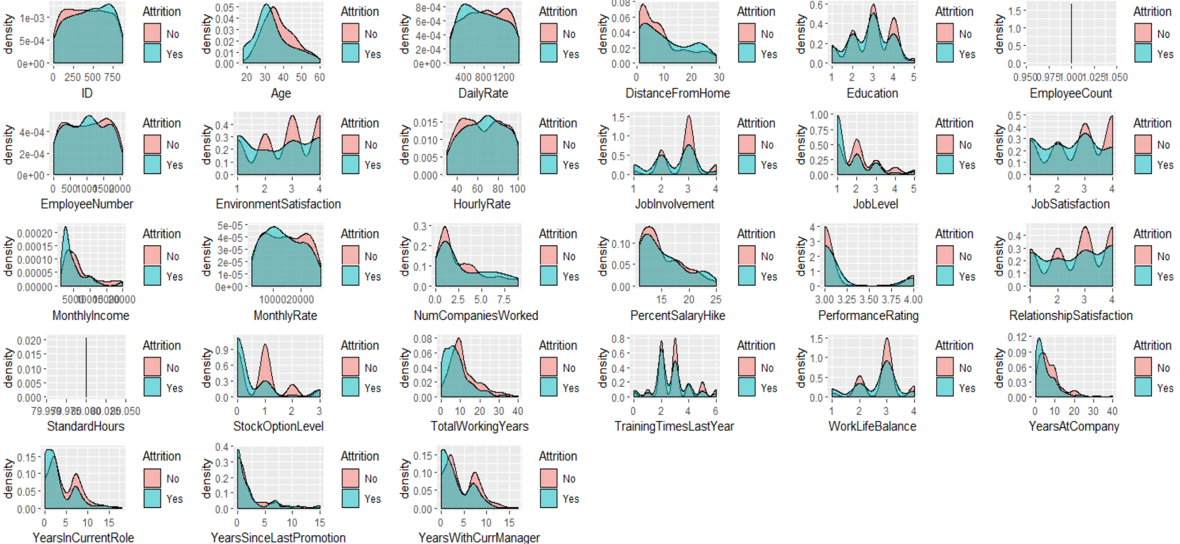
Exploratory Data Analysis (EDA)

Slide 8
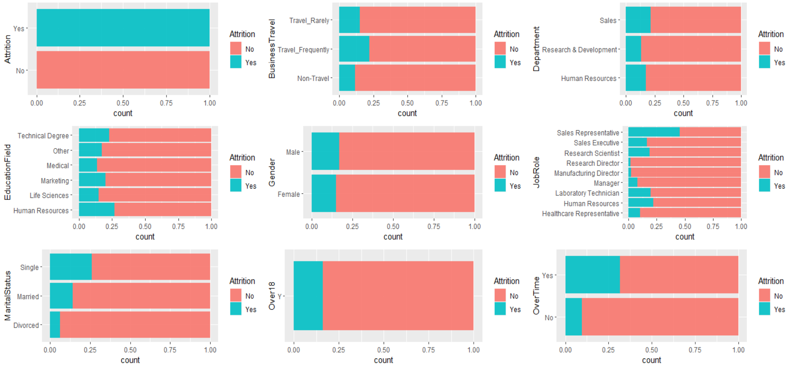
Exploratory Data Analysis (EDA)

Slide 9
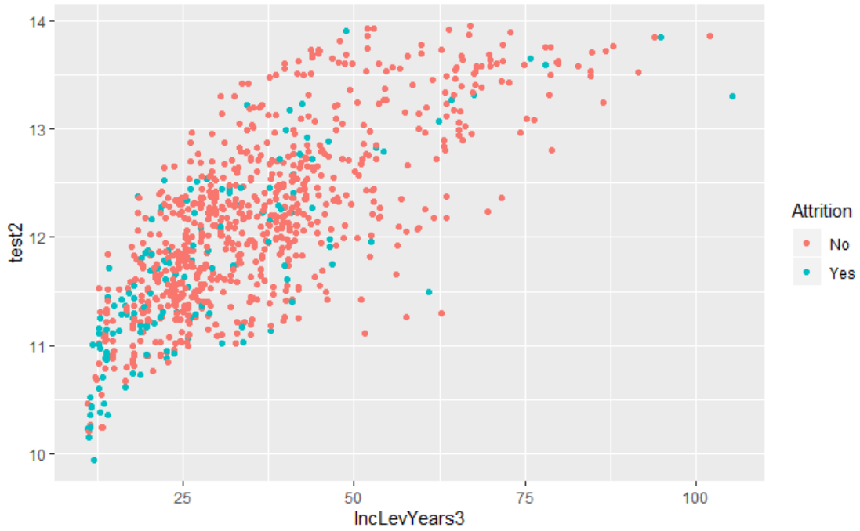
Classification: Attrition (KNN)

Slide 10
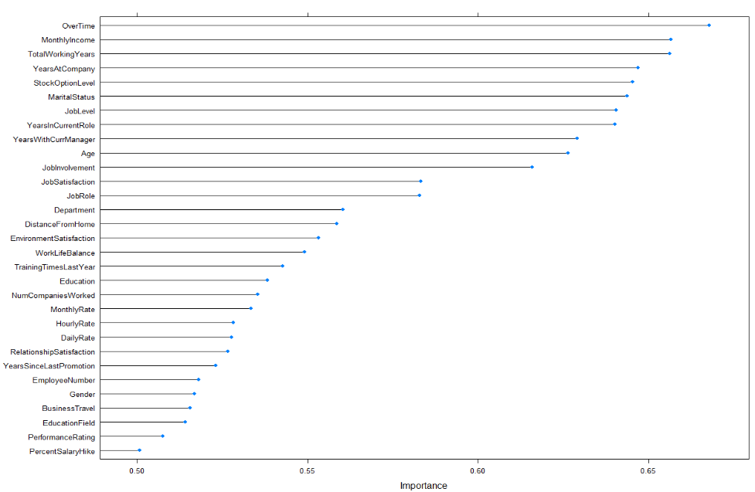
Most Important Predictors of Attrition (KNN)

Slide 11
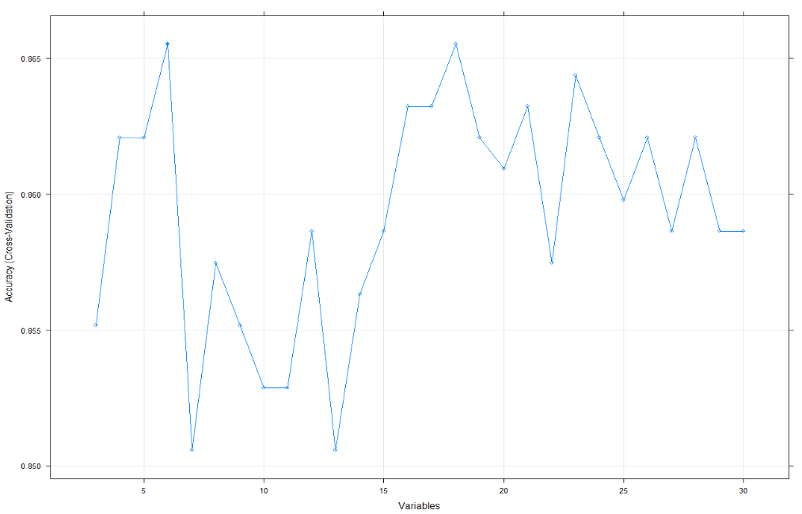
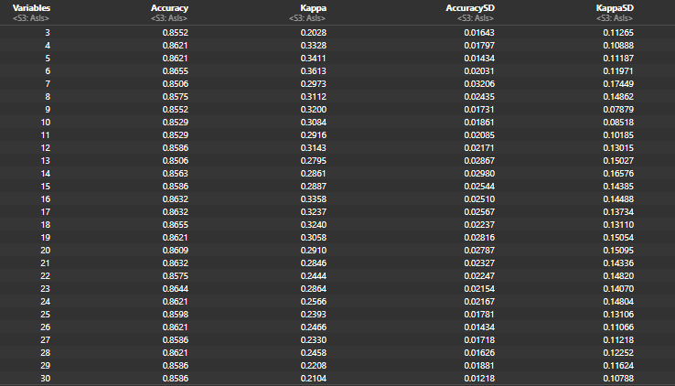
KNN Model – Optimization
Top 6 variables Selected: Overtime, Monthly Income, Stock Option Level, Job Role, Job Level, and Marital Status

Slide 12
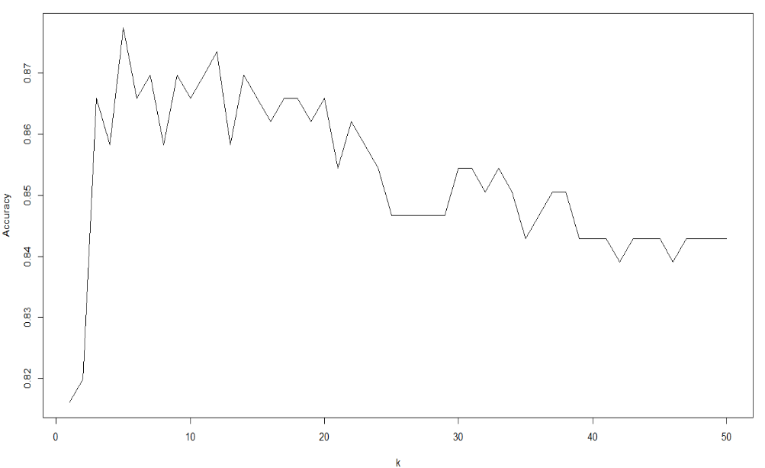
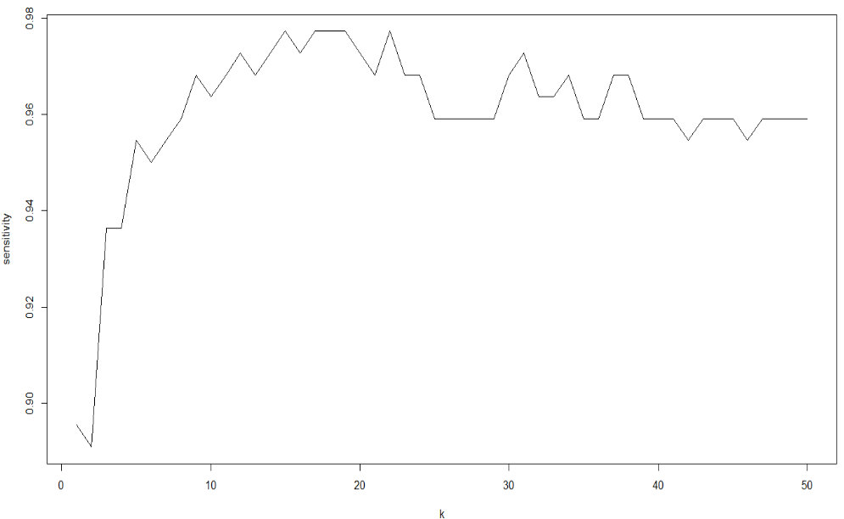
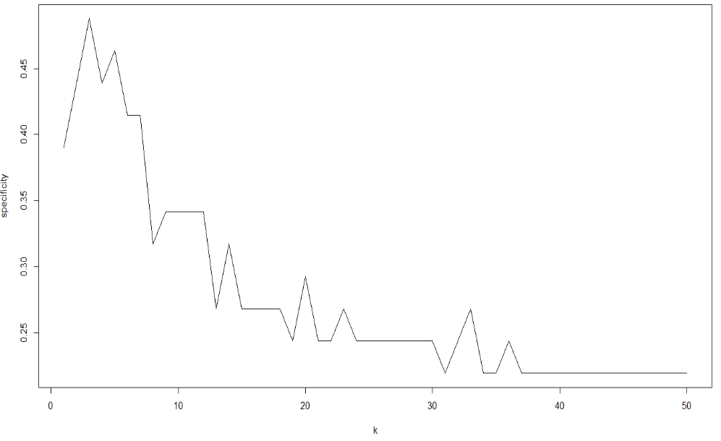
KNN Model – Optimization
Top 6 variables Selected: Overtime, Monthly Income, Stock Option Level, Job Role, Job Level, and Marital Status

Slide 13
KNN Model – Prediction
 | No | Yes
No | 206 | 21
Yes | 14 | 20
Sensitivity = 93.6%
Specificity = 48.8%
Accuracy = 86.6%
Top 6 variables Selected: Overtime, Monthly Income, Stock Option Level, Job Role, Job Level, and Marital Status

Slide 14
Monthly Income Predictor (Simple Linear Regression)
Stepwise Variable Selection
Variables Selected:
Job Level
Job Role
Total Working Years
Business Travel
Gender
R2 | Adj. R2 | RMSE
0.948 | 0.947 | 1054.72

Slide 15
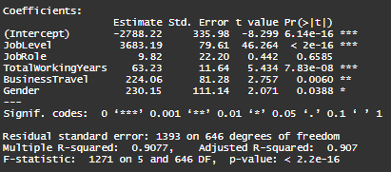
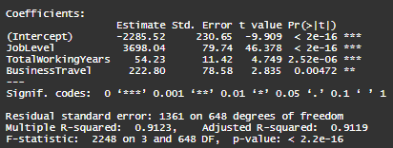
Monthly Income Predictor (Simple Linear Regression)
Cross Validation
Variables Selected:
Job Level
Job Role
Total Working Years
Business Travel
Gender
R2 | Adj. R2 | RMSE
0.948 | 0.947 | 1054.72
RMSPE: 1,422
RMSPE: 1,311

Slide 16

Conclusion
Covered the data set
Performed some initial analysis
Created a classifier to identify at-risk employees
Created a model to predict monthly income

